Slide 1

RMD Sinhgad School of Engineering
Department of Computer Engineering
“Botnet of Things”
Presented by :
NAME : Sagar Bhadke
BE- A
Roll No: 16

Slide 2
CONTENT:
What are Botnets?
Botnet Terminology
Botnet Life-cycle
Types of attacks
Botnets in Network Security
Conclusion

Slide 3
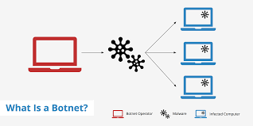
What are Botnets?
A Botnet is a network of compromised computers called Zombie Computers or Bots, under the control of a remote attacker.
Bots began as a useful tool. They were originally developed as a virtual individual that could sit on a IRC channel & monitor network traffic.
They are significant contributors to the malicious & criminal activities on the Internet today and far importantly an underground network whose size & scope is not fully known.

Slide 4
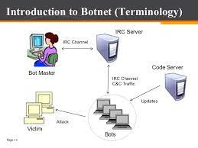
Botnet Terminology
Bot Herder(Bot Master)
Bots
IRC Server
Command & Control Server (C&C)

Slide 5
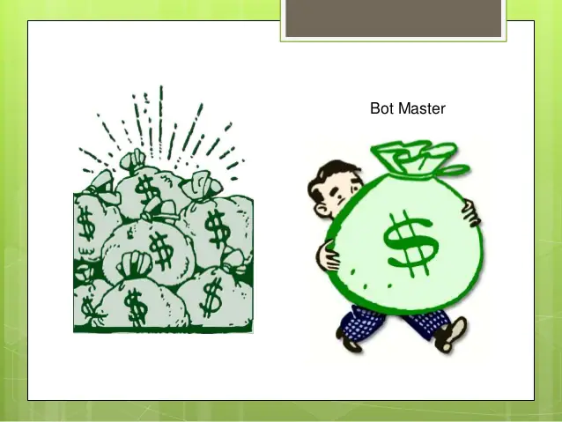
Bot Herder:
Bot herders(aka Bot Masters)are the hackers who use automated techniques to scan specific network ranges and find vulnerable systems, on which they can install their bot program.
To create an army of Zombies over internet, attacker typically infect machines of home users, network maintained by universities or small enterprises, etc.

Slide 6
Bot Master
A botmaster is a person who operates the command and control of botnets for remote process execution.
The botnets are typically installed on compromised machines via various forms of remote code installation.

Slide 7
Bots:
Bots (also called Zombie Computers)are the computers that contribute to the botnet network.
They run using a hidden channel to communicate to their C&C server.
They can auto scan their environments and propagate themselves taking advantage of vulnerabilities &weak passwords.

Slide 8
IRC Server
Internet Relay Chat (IRC) is a form of real-time Internet text messaging (chat).
The server listens to connections from IRC clients enabling people to talk to each other via the Internet.
Most IRC servers do not require users to register an account but a user will have to set a nickname before being connected.
Most IRC networks lack any strong authentication, and a number of tools to provide anonymity on IRC networks are available.
IRC provides a simple, low-latency, widely available, and anonymous command and control channel for botnet communication.

Slide 9
Command & Control Server:
C&C infrastructure allows a bot agent to receive new instructions, malicious capabilities, update existing infections or to instruct the infected computer to carry out specific task as dictated by the remote controller.
The criminal actively controlling botnets must ensure that their C&C infrastructure is sufficiently robust to manage tens-of-thousands of globally scattered bots as well as resist attempts to hijack or shutdown the botnet.

Slide 10
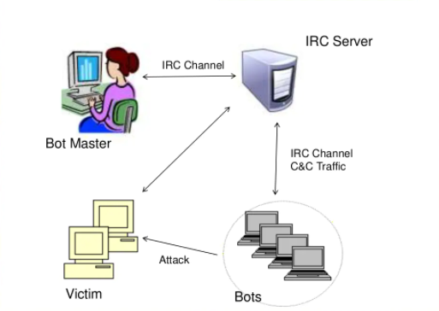

Slide 11
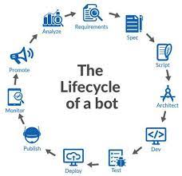
LIFE CYCLE:

Slide 12
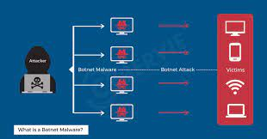
Types of attacks :
Distributed Denial of Service (DDoS) attacks
Sending Spams
Phishing (fake websites)
Adware
Spyware (keylogging, information harvesting)
Click Fraud

Slide 13
Botnets In Network Security:
Internet users are getting infected by bots.
Many times corporate and end users are trapped in botnet attacks.
Today 16-25% of the computers connected to the internet are members of a botnet.
According to Damballa’s Technical report, 83.1% of global spam in March,2011 was sent by Botnets.
Computer security experts estimate that most Spam is sent by home computers that are controlled remotely & millions of these computers are part of Botnets.

Slide 14
- Most Wanted Botnets :
Zeus- Compromised U.S. 3.6 million computers.
Koobface- Compromised U.S. 2.9 million computers.
TidServ- Compromised U.S. 1.5 million computers.
Trojan.Fakeavalert- Compromised U.S. 1.4 million computers.
TR/Dldr.Agent.JKH- Compromised U.S. 1.2 million computers.

Slide 15
Conclusion:
Botnets are one of the biggest threats to the Internet today, and they are linked to most forms of Internet crime. Most spam, DDoS attacks, spyware, click fraud, and other attacks originate from botnets and the shadowy organizations behind them.
Running a botnet is immensely profitable, as several recent high-profile arrests have shown. Currently, many botnets still rely on a centralized IRC C&C structure, but more and more botmasters are using P2P protocols to provide resilience and avoid a single point of failure.

Slide 16
Thank You

